Slide 1
Hotel Management System
Submitted By
16.01.04.055
16.01.04.059
16.01.04.072
16.01.04.074

Slide 2
Sampling Decisions
Facebook
Email
WhatsApp

Slide 3
Sample Design
Sample Size : The sample size selected for the research is 40.
Parameters of interests : The major parameters of interest is the subgroup of people having experience in hotel job.

Slide 4
Data Collection Tool Used
Questionnaires.

Slide 5
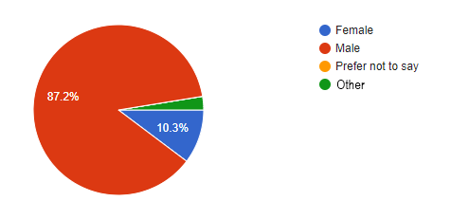
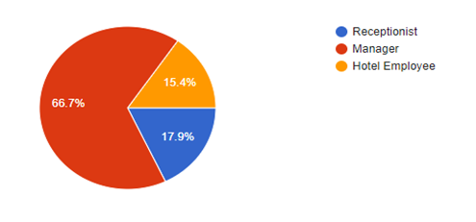
Gender
Occupation

Slide 6
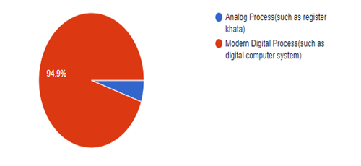
What will be better for managing a hotel's information?

Slide 7
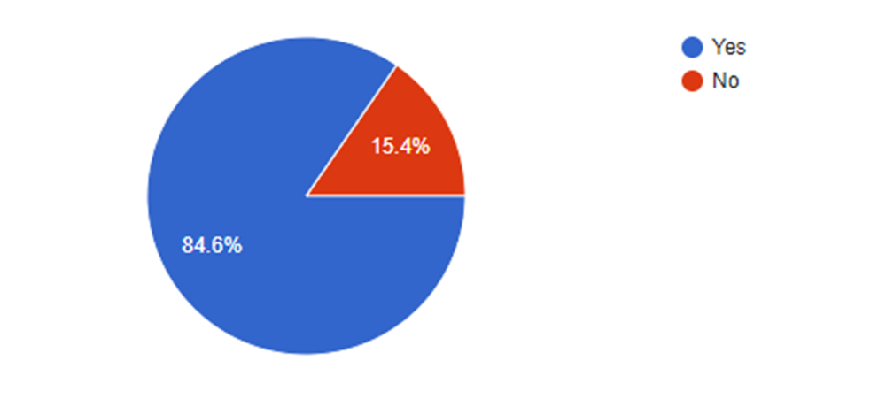
Have you ever faced troubles in analog system ?

Slide 8
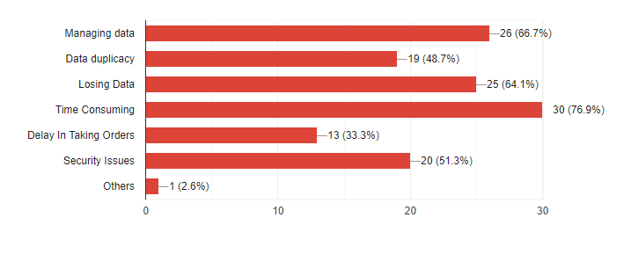
What kinds of problems have you faced in analog system ?

Slide 9
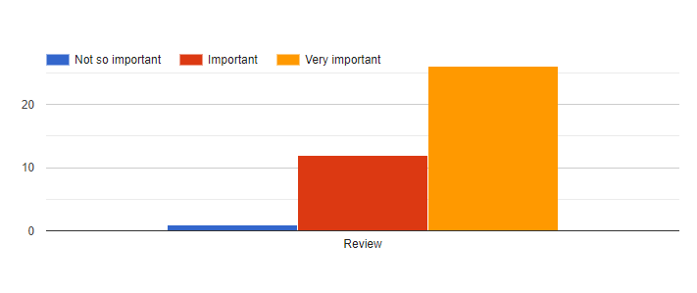
Do you think it is important to digitalize the analog system?

Slide 10
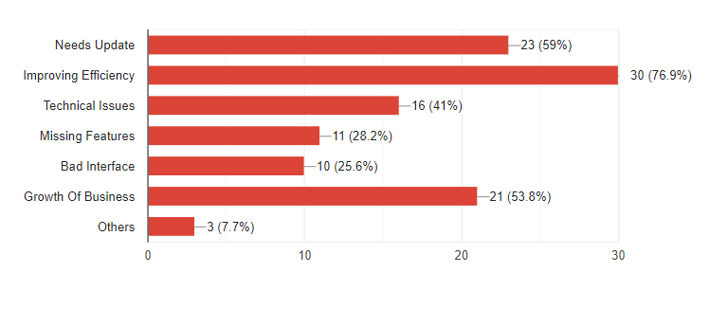
Reasons for replacing the current analog system :-

Slide 11
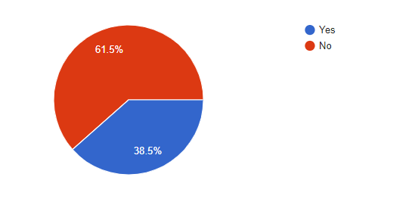
Have you ever used a computerized system to manage your hotel ?

Slide 12
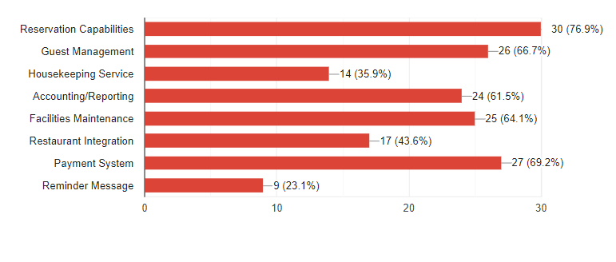
Which features you want in your system from below ?

Slide 13
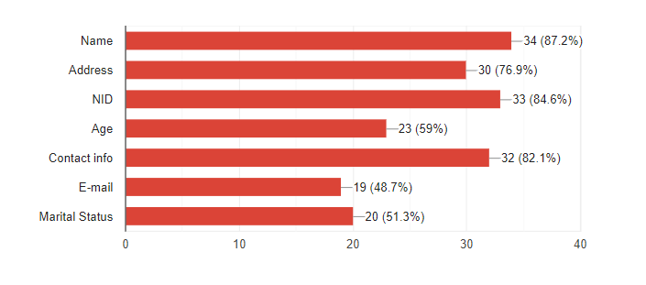
What kind of information would you like to take from a customer?

Slide 14
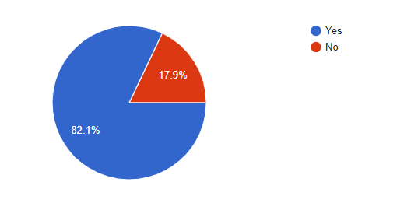
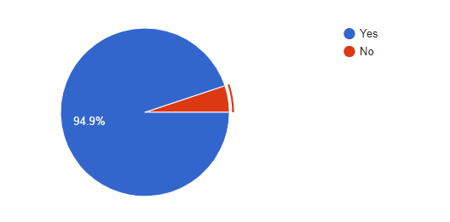
Do you prefer staff information onto the system?
Do you prefer separate accounts and authorized access for every employee?

Slide 15
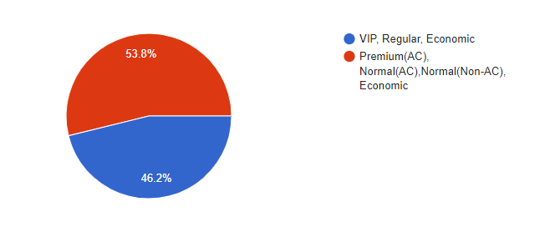
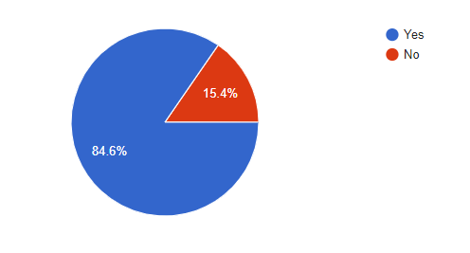
What categories of room you prefer in this system?
Would you prefer room pictures in your system?

Slide 16
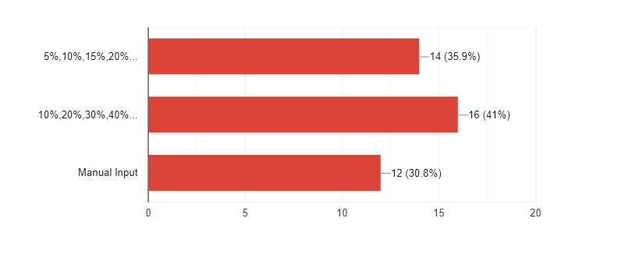
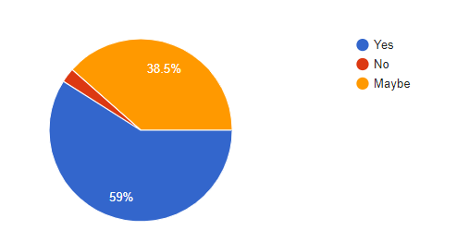
The discount margin should be –
Would you like to prefer discount system in your application ?

Slide 17
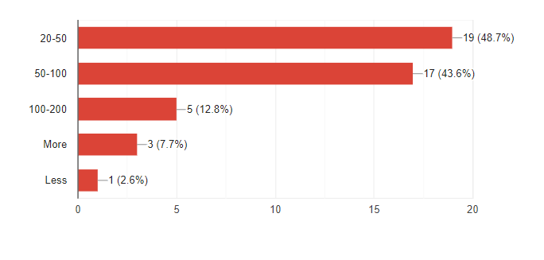
How many visitors come to your hotel per day on average?

Slide 18
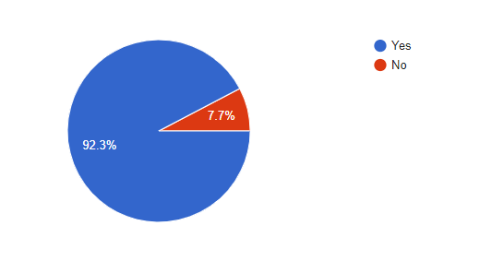
Would you prefer separate food menu system for separate day-hour and also with their pictures?

Slide 19
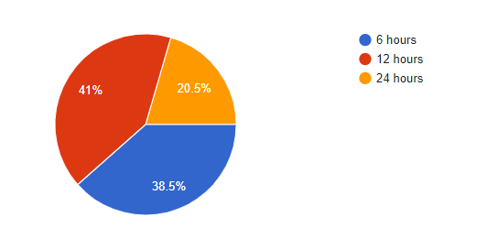
What will be the minimum time to book a room for a customer?

Slide 20
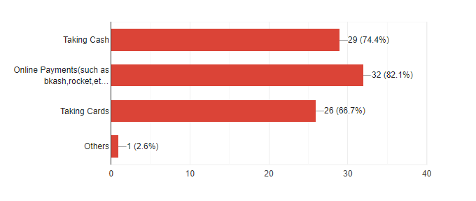
In which way you prefer the payment system should be?

Slide 21
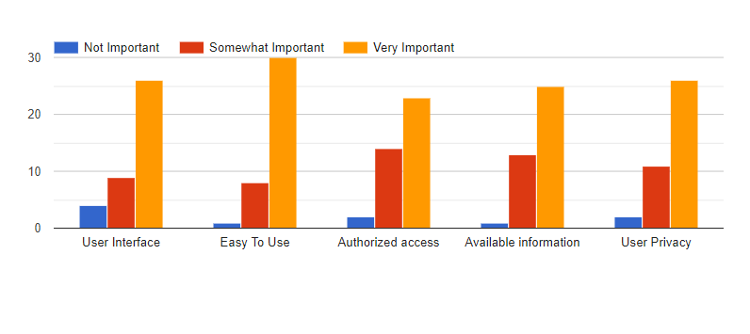
When using our system, as a user what affects your satisfaction the most?

Slide 22
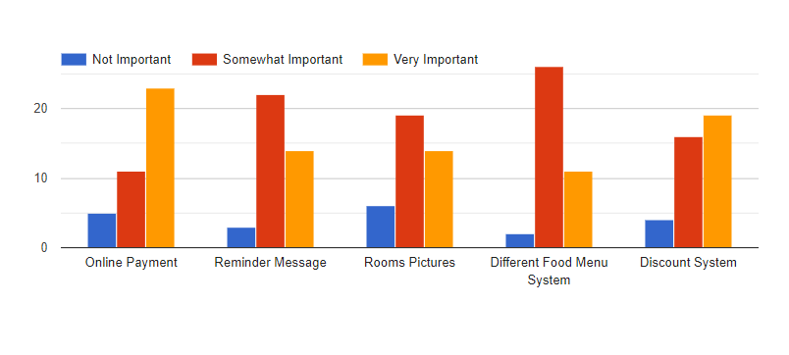
Managing the system what importance these features will make?

Slide 23

“Overall findings of this survey”
Thank You

Slide 24

Any Query

